Slide 1
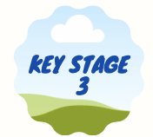
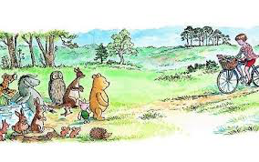
How many books containing talking animals can you name?
Binfield Badger Group, supporting Berkshire's badgers

Slide 2
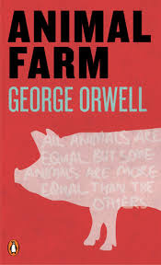
Learning objective: to develop ‘anthropomorphic’ writing
Level 1: Developing an ‘anthropomorphic’ description
Level 2: Analysing an ‘anthropomorphic’ story
Level 3: Developing an ‘anthropomorphic’ story
Vocabulary: anthropomorphism
Binfield Badger Group, supporting Berkshire's badgers

Slide 3
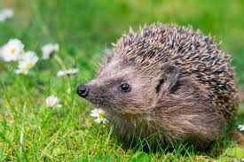
Level 1: Developing an ‘anthropomorphic’ description
Have a look at this hedgehog.
What is her name and what is her personality like?
What is she thinking?
Binfield Badger Group, supporting Berkshire's badgers

Slide 4
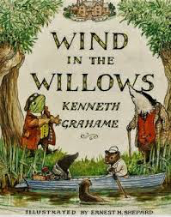
Level 2: to analyse an ‘anthropomorphic’ story
The Wind in the Willows is an anthropomorphic story about Ratty, Mole, Badger and Mr Toad.
Please read the extract about Badger on the next slide. Write down any description in the text that makes him anthropomorphic (like a human).
Explain how this extract makes him like a human.
Binfield Badger Group, supporting Berkshire's badgers

Slide 5
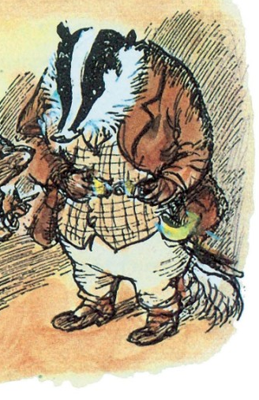
An extract from ‘Wind in the Willows’ (by Kenneth Grahame)- Badger
The Badger, who wore a long dressing-gown, and whose slippers were indeed very down at heel, carried a flat candlestick in his paw and had probably been on his way to bed when their summons sounded. He looked kindly down on them and patted both their heads. `This is not the sort of night for small animals to be out,' he said paternally. `I'm afraid you've been up to some of your pranks again, Ratty. But come along; come into the kitchen. There's a first-rate fire there, and supper and everything.' He shuffled on in front of them, carrying the light, and they followed him, nudging each other in an anticipating sort of way, down a long, gloomy, and, to tell the truth, decidedly shabby passage, into a sort of a central hall; out of which they could dimly see other long tunnel-like passages branching, passages mysterious and without apparent end. But there were doors in the hall as well--stout oaken comfortable-looking doors. One of these the Badger flung open, and at once they found themselves in all the glow and warmth of a large fire-lit kitchen. The kindly Badger thrust them down on a settee to toast themselves at the fire, and bade them remove their wet coats and boots. Then he fetched them dressing-gowns and slippers, and himself bathed the Mole's shin with warm water and mended the cut with sticking-plaster till the whole thing was just as good
as new, if not better.
Binfield Badger Group, supporting Berkshire's badgers

Slide 6
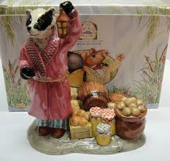
Binfield Badger Group, supporting Berkshire's badgers

Slide 7
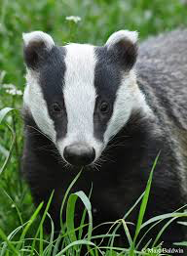
Level 3: developing an ‘anthropomorphic’ story
Think about what a badger looks like.
Think about how a badger behaves.
Think about how a badger moves.
If a badger were human:
What sort of personality would he/she have?
What would his/her voice sound like?
What sort of job would he/she do?
What sort of home would a badger have? How would it be decorated?
What sort of clothes would a badger wear?
What sort of hobbies might he/she have?
Binfield Badger Group, supporting Berkshire's badgers

